Slide 1

Cyber Security Awareness Event
MDC Cybersecurity
10/9/2022
Notes:
October 3rd, 2022 - Friends and family, focus on how to keep cyber safe!

Slide 2
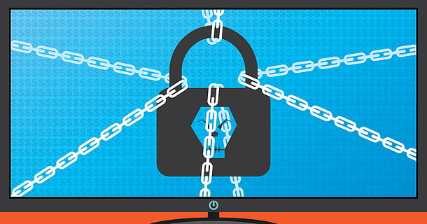
Objectives
Cybersecurity awareness helps educate people about malicious methods used to target common people.
We must learn about basic principles of cybersecurity so that we may spot potential threats and what we can do to avoid falling victim to these insidious threats
Why are we here?

Slide 3

Introductions
Presenter Intros
Who are we?
Professional Background?
Attendee Intros
Your name and where you are from?
Professional Background?
Any affiliations with Cybersecurity?

Slide 4
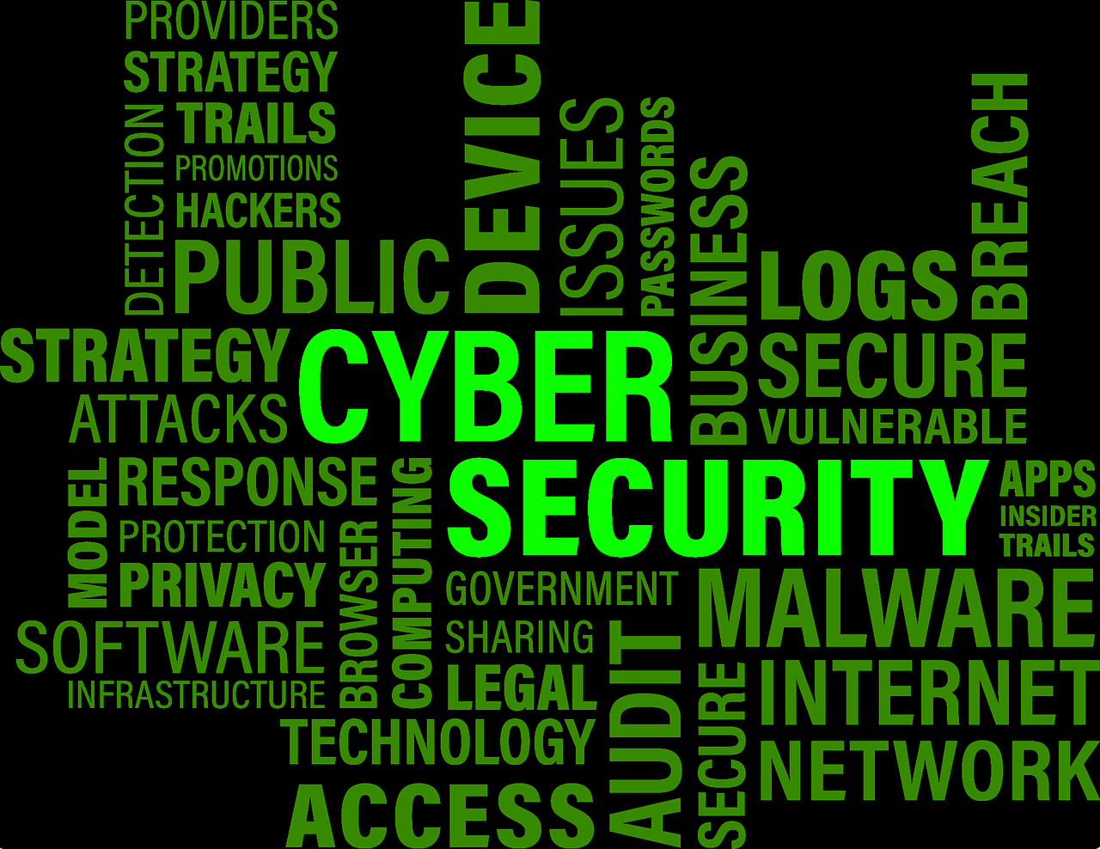
Principles of Cybersecurity

Slide 5
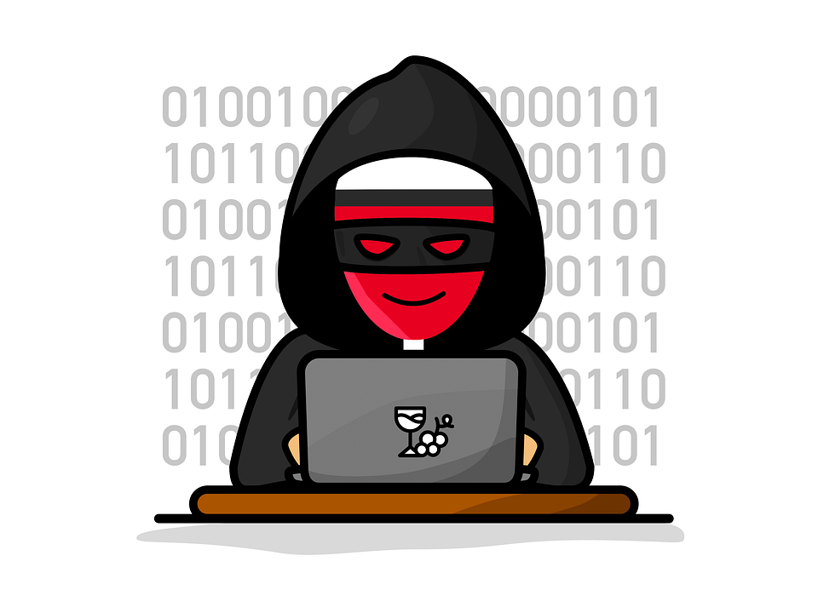
What are we talking about? What’s Cybersecurity?
One word: Protection
Many things to protect
Computers
Servers
Cars
Phones
IoT (Internet of Things)
What do you think is the most important to protect?
Protect from whom? Attackers

Slide 6
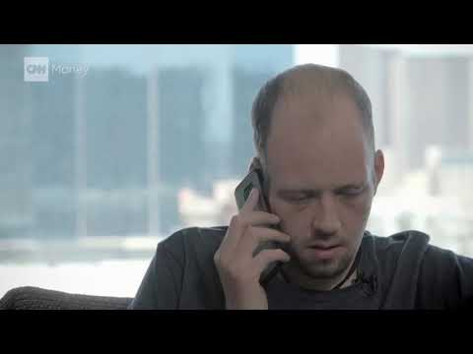
Is it really that easy?

Slide 7
What is malware?
Malware refers to any intrusive software developed by cybercriminals with the intention of sealing, damaging, or destroying data via the use of Trojan Viruses, ransomware, etc.
There are various common approaches that can help defend you from such attacks such as keeping your system up to date with the latest virus signatures, or maintaining anti-malware programs and using live scans on your system.
To avoid malware, be vigilant and avoid downloading and installing anything you do not understand or trust.

Slide 8
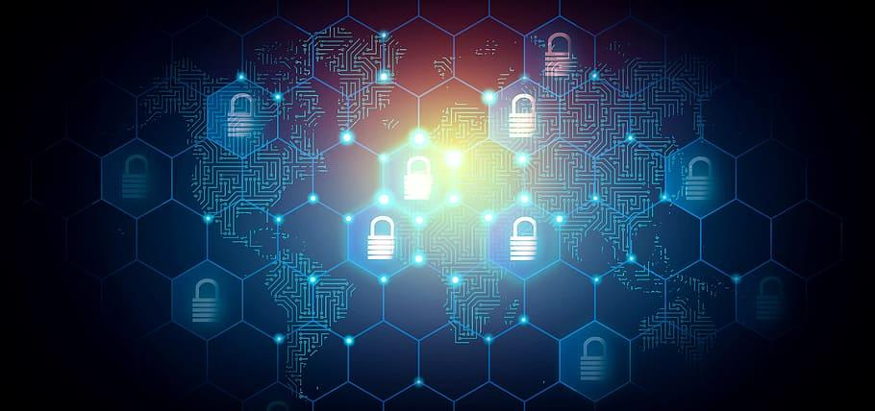
How many attacks in a day?
Cyber-attack occurs somewhere in the world, every minute
Real-time attack maps
Live Cyber Threat Map | Check Point
Fortinet Threat Map (fortiguard.com)
Fun fact: Cyber attacks are more effective in bringing down an F-35 jet than a missile. Do not underestimate such a deadly attack!

Slide 9
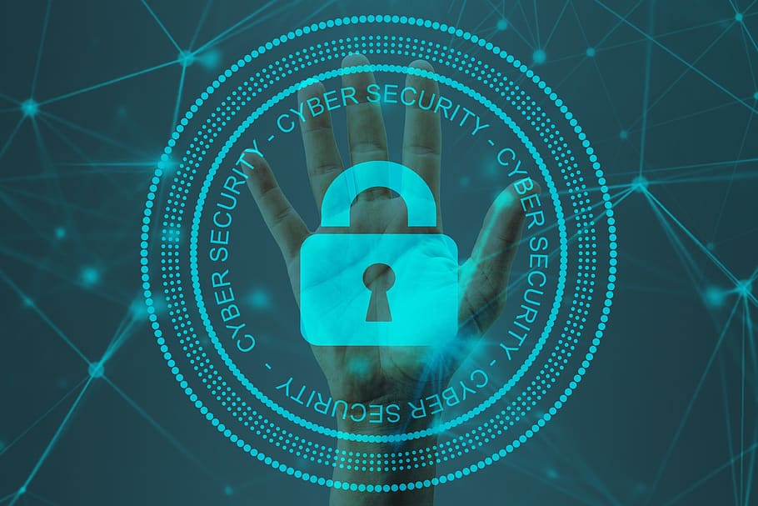
How do we protect ourselves?
Guidelines
Manufacturers of systems (Apple, Samsung, etc.) provide best practices
NIST
SANS
Suggestions
Password strength
Security feature implementations
Backups
And More!

Slide 10
Best Practices!
Keep software up to date
Avoid opening suspicious emails
Keep hardware up-to-date
Use anti-virus and anti-malware
Use a VPN to privatize your connections
Don’t be lazy with your passwords!
Enable Two-Factor Authentication
Disable Bluetooth when you don;’t need it

Slide 11
Password Security
Use a unique complex password that is minimally 8 characters long, with unique special characters with both lowercase and uppercase letters.
Always log off, if you leave your device unattended, it will take only a few seconds for someone to compromise your private data.
Avoid entering passwords on computers you don’t control, there may be key loggers that you may not be aware of.
Change your passwords regularly and avoid using the same password for all of your accounts.

Slide 12
How can I know more?
Attend more awareness conferences, just like this one!
Online resources, such as:
The Weakest Link: A User Security Game (isdecisions.com)
Department of Homeland Security Kicks Off Cybersecurity Awareness Month
Cybersecurity awareness tips from Microsoft
Some Scary Cyber Threat Stats

